Slide 1
The Curious Developers!!
Bannari Amman Institute of Technology

Slide 2
SHARE DO
Naveen V M (201CS229)
Sanjay Rahul S (201CS271) Sanjith S (201CS273)
B.E.Computer Science and Engineering Bannari Amman Institute of Technology.

Slide 3



SHARE DO
A MOBILE APPLICATION HELPS YOU TO STAY PRODUCTIVE

Slide 4
Abstract Link
https://drive.google.com/file/d/1MSlBeS61 oXvM93DCYbKsaBFBNJfc-c0k/view? usp=sharing

Slide 5



Problem
The major problems faced by students, freelancers and working employees that is not being productive!

Slide 6
Existing Solution
There are many to do list apps that
helps to keep track of our tasks!

Slide 7

What does survey says?
Nearly two third takes to do
41% leaves incomplete

Slide 8


Solution
The problem can be solved using a
mobile application
The concept of application is mainly sharing their tasks with other .

Slide 9

How it works?
1.
Create tasks in the app

Slide 10

2. Share your Tasks with groups and friends

Slide 11



3. Complete a task, get points

Slide 12



Share your tasks Complete your Task!!
They can share the total number of tasks and once they complete a single task they will get some points

Slide 13



Advantages :
There is a huge possibility of completing all the tasks for the day
Sharing of targets and goals

Slide 14

Target Users:
Working Professionals
Students

Slide 15
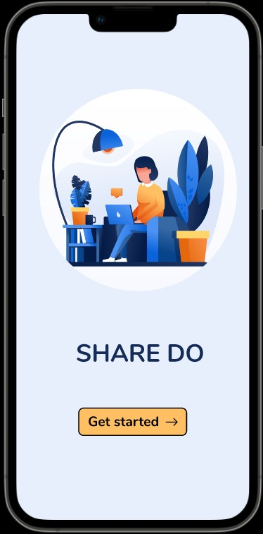
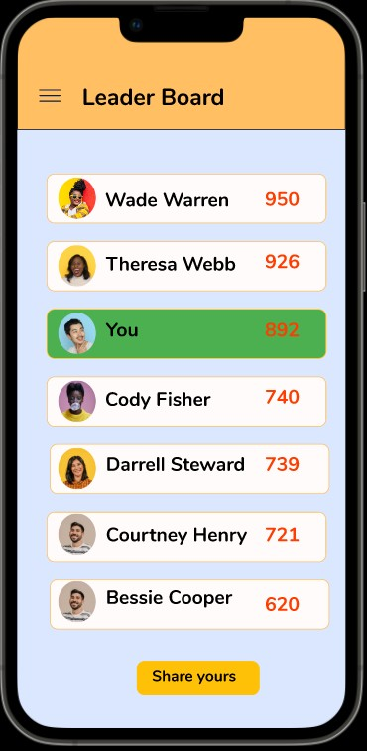
Prototype :

Slide 16
Thank You
Prepared By,
NAVEEN V M SANJAY RAHUL S SANJITH S

